Slide 1


The Dumb Warrior: An Engaging Online Adventure
"The Dumb Warrior" is a narrative-driven web game that reimagines linear console gameplay into an interactive online experience. Players embark on a whimsical journey with Leo, an unlikely hero wielding a frying pan, making humorous choices that shape the story. This project highlights the impact of player decisions and the rich storytelling intertwined with vibrant gameplay.

Slide 2



Project Goal: From Console to Web
Our primary goal was to transform the console game into a web-based experience, improving player interactivity and engagement. We prioritized the game's narrative while utilizing modern web technologies to create an immersive and visually appealing environment.
Objective
Technologies Used
Focus on Learning
Create a web-based game for enhanced interactivity.
Utilized HTML, CSS, and JavaScript for development. Plus Flask Python for Backend server.
Implemented complex game logic and intuitive UI designs.

Slide 3



Meet Leo: The Unlikely Hero
Courageous Spirit
2
Leo confronts danger with naive misunderstanding, inviting affection.
Unconventional Hero
Equipped with a frying pan, Leo humorously challenges traditional heroes.
1
3
Engaging Narrative
Players sympathize with Leo's humorous quest to slay the dragon.

Slide 4






The Story: Choices & Consequences
The story follows Leo navigating choices at a crucial moment in his adventure. Each decision impacts the narrative and leads to unique experiences, emphasizing player agency. The humor and unpredictability keep every play session fresh and engaging, creating a deeper connection to Leo as players reflect on the consequences of their choices.
1
2
3
Fork in the Road
Humor & Unpredictability
Player Agency
Leo faces decisions that shape his adventure uniquely.
The game includes humorous encounters like grizzled adventurers and a sleeping dragon.
Every choice has significant consequences, fostering emotional investment.

Slide 5
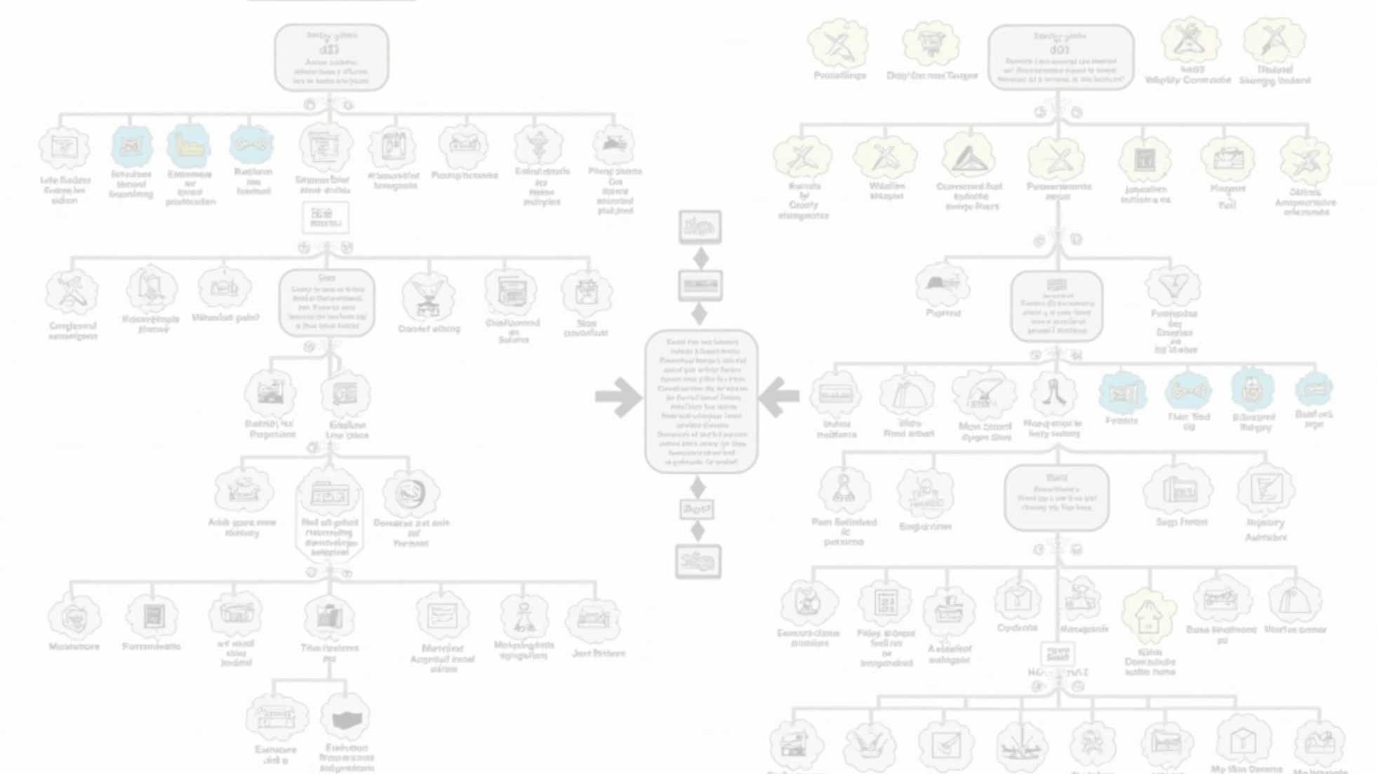


Visualizing the Adventure
The adventure's structure is illustrated through a flowchart that captures the complex narrative while maintaining an accessible interface. This visualization helps players understand the overarching storyline and appreciate the intricacies of branching paths, clarifying their journey and critical decisions.
1
2
3
Start Point
Divergent Decisions
Impact of Choices
Choosing between the Dark Path and Sunny Path.
Each path leads to unique scenarios and endings.
Decisions influence the storyline from humor to high stakes.

Slide 6
Technical Stack & Architecture
Client-Side Logic
2
Game logic is managed in real-time via Python backend server.
Web Technologies
1
HTML5, CSS, and JavaScript for a seamless user experience.
Inventory Tracking
3
Variable tracks player inventory and updates the UI dynamically.

Slide 7


Implementation & Challenges
Transitioning the narrative engine presented both opportunities and challenges. Our experience in converting C functions to JavaScript emphasized the importance of maintaining game logic while enhancing player interaction through event listeners. The process of tracking the game state developed our debugging skills and deepened our grasp of state management in JavaScript.
Narrative Engine Conversion
Event Handling Implementation
Game State Tracking Challenge
Restructured C functions into JavaScript to maintain game logic.
Ensured inventory consistency across different scenes through rigorous testing.
Utilized JavaScript event listeners for player interactions.

Slide 8
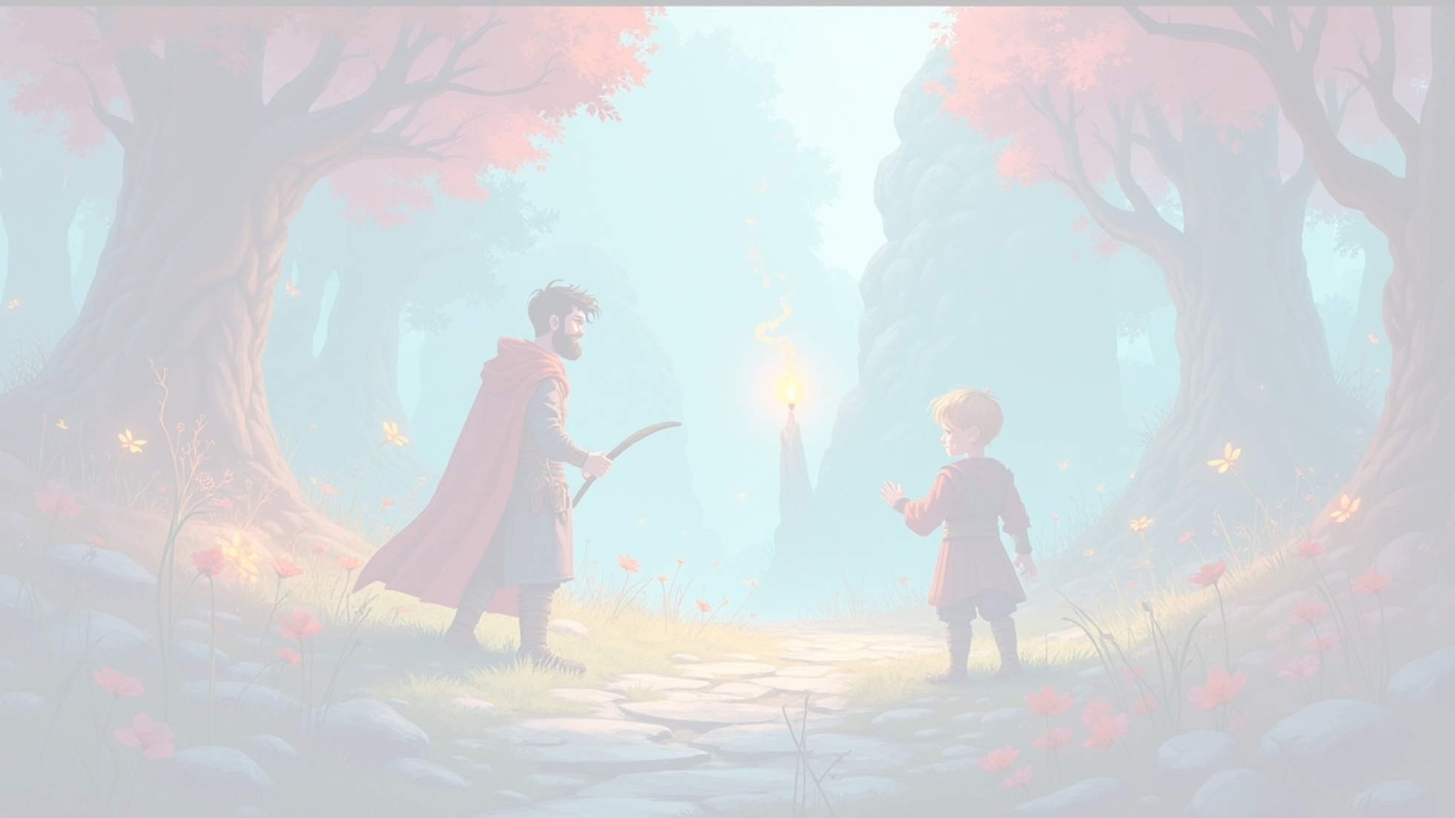
Live Demonstration of The Dumb Warrior
This live demonstration of 'The Dumb Warrior' will present the web application's features, emphasizing the interactive storytelling and comedic elements of Leo's journey. We will explore player choices that shape the narrative while showcasing the evolving UI that responds dynamically to decisions made throughout the gameplay.
1
2
3
Select Dark Path
Obtain Fire Rune
Create Diversion
Exploring player choices and their impact on the adventure.
Demonstrates the consequence of leaving adventurers alone.
Leads to a winning ending in the dragon's lair.

Slide 9



Lessons Learned & Future Adventures
Back end server using Python
2
Effective methods for dynamic UI updates, ensuring a seamless player experience.
Game Logic Translation
Learning experiences in translating from C to Python, enhancing understanding of programming languages.
1
Future Enhancements
3
Plans to implement localStorage and enrich storytelling with new features.

Slide 10
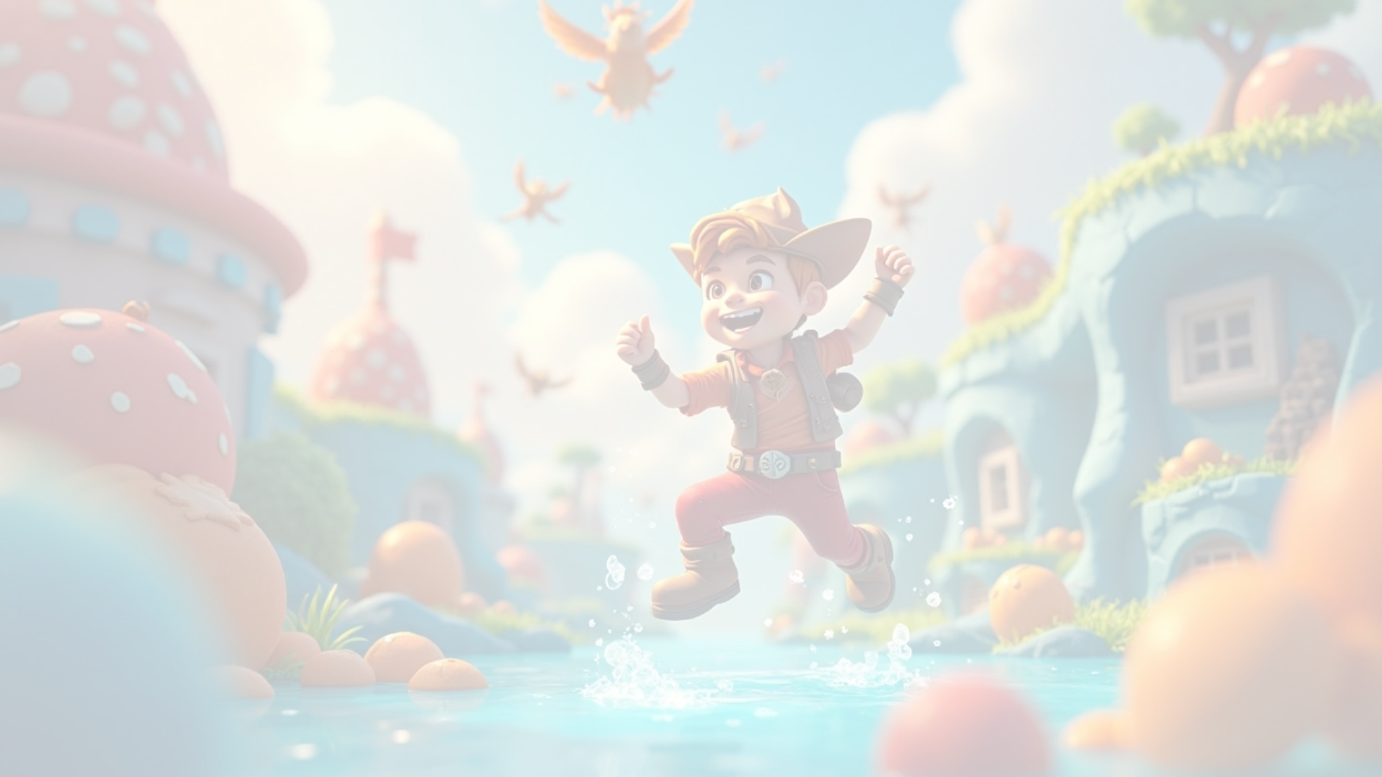




Project Conclusion
In conclusion, our project not only brings Leo's misadventures to life but also emphasizes the importance of creativity in game development. We invite players to immerse themselves in 'The Dumb Warrior,' underscoring our dedication to interactive narratives and engaging gameplay.
1
2
3
Successful Transformation
Understanding Frontend Development
Future Project Foundation
We successfully transformed a console narrative into an engaging web game.
Innovative solutions pave the way for future engaging projects.
Our project demonstrates a thorough understanding of frontend web practices.

Slide 11



Q&A Session
1
Opportunity for Questions
We welcome any questions you might have regarding our project.
2
Feedback Importance
Your feedback is invaluable for our development process.
3
Insight Sharing
We are eager to share insights from our experience.

